Slide 1


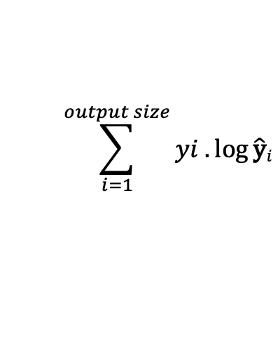
$$\sum_{i=1}^{output size}{yi .\log{\hat{\text{y}}i}}$$
$$Loss= _$$
Softmax
Bidirectional GRU
Deep Network
Layer
Bidirectional LSTM
Bidirectional GRU
Bidirectional GRU
e₁
e₂
e_{n}
Embedding Layer
. . . . .
fastText
. . . . .
p₁
p₂
p₃
p_{t-1}
p_{t}
LinkedIn Posts

Slide 2




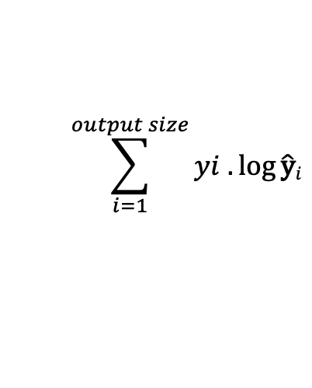


$$\sum_{i=1}^{output size}{yi .\log{\hat{\text{y}}i}}$$
$Loss=$ _
🙁
😟
😭
$hik=Model(eix$)
$Model∈$ {Deep RNN, BERT, roBERTa}
$eix=\{$ fastText(P_{i}), Glove(P_{i}), Google _w2v(P_{i}) $\}$
Cleaning / Pre-processing
#layoffs
#protests
Weak Supervised Learning
[#hashtag scraping]
#excited
#opentowork
#newjob
LinkedIn Posts : $Pi ∈\{pi1, pi2, …,pit\}$

Slide 3

Softmax
$hik=Model(eix$)
$Model∈$ {Deep RNN, BERT, roBERTa}
$eix=\{$ fastText(P_{i}), Glove(P_{i}), Google _w2v(P_{i}) $\}$
Cleaning / Pre-processing
#layoffs
#protests
Weak Supervised Learning
[#hashtag scraping]
#excited
#opentowork
#newjob
LinkedIn Posts : $Pi ∈\{pi1, pi2, …,pit\}$

Slide 4



Slide 5





Slide 6
$$\sum_{i=1}^{output size}{yi .\log{\hat{\text{y}}i}}$$
$$Loss= _$$
Softmax
Bidirectional GRU
Deep Network
Layer
Bidirectional LSTM
Bidirectional GRU
Bidirectional GRU
e₁
e₂
e_{n}
Embedding Layer
. . . . .
fastText
. . . . .
p₁
p₂
p₃
p_{n-1}
p_{n}
LinkedIn Posts

Slide 7
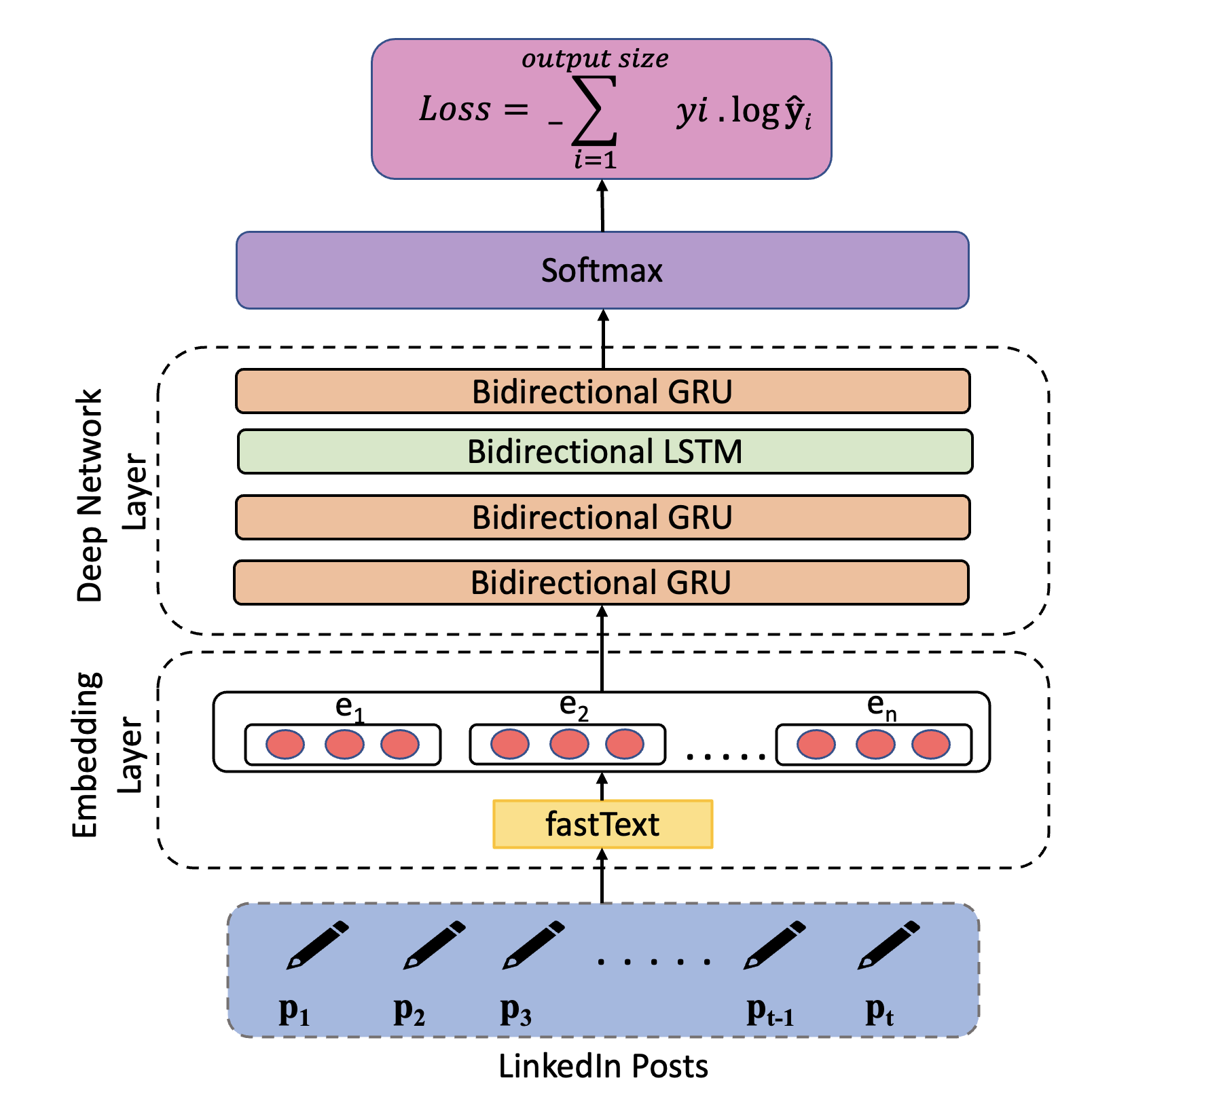


Slide 8
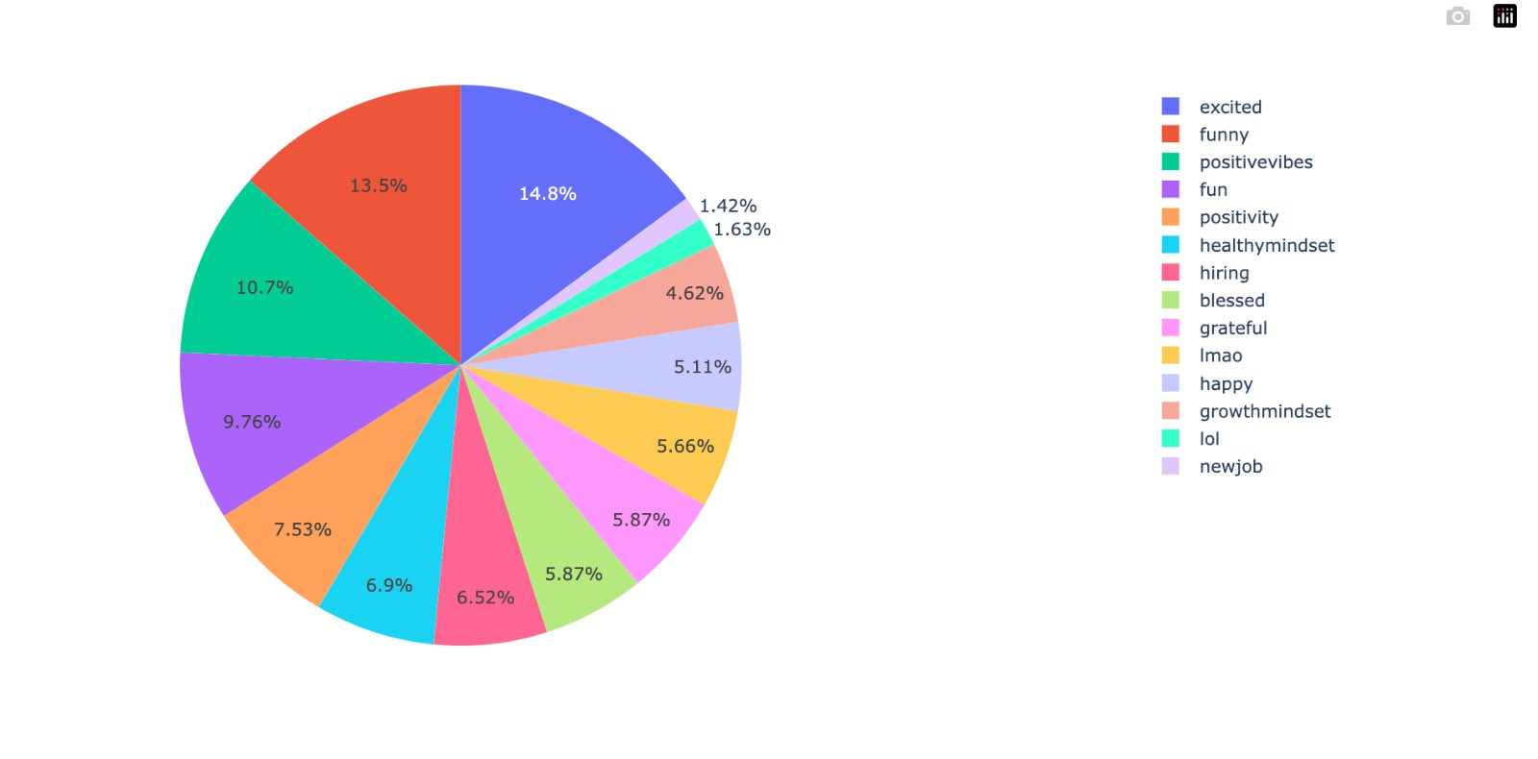

Slide 9
